Slide 1
MAXIMIZE YOUR POTENTIAL: EXECUTIVE COACHING FOR SUCCESS
September 25, 2019

Slide 2
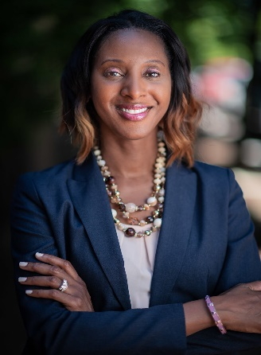
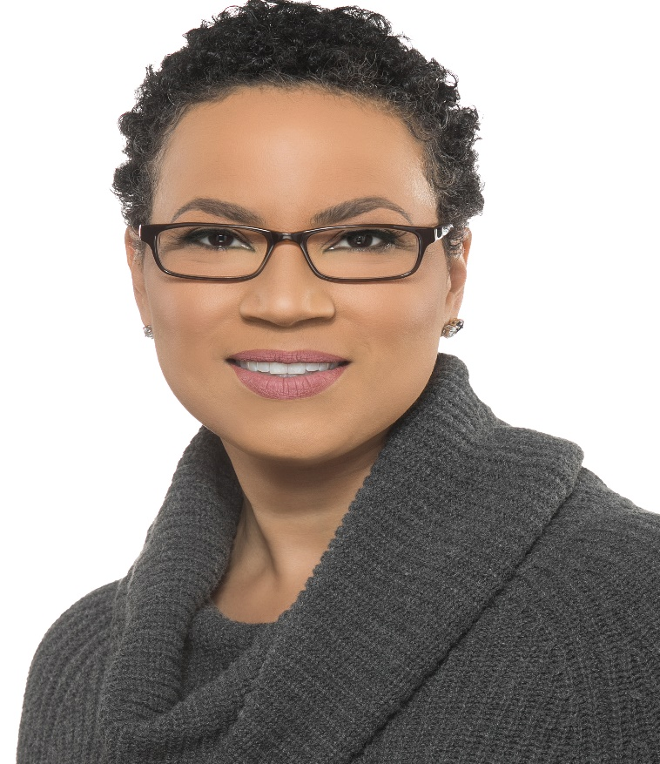
Speakers
Shauna Bryce, Bryce Legal
Career Strategist for Lawyer
Karen Mccain Borno
Managing Associate General Counsel, Verizon

Slide 3
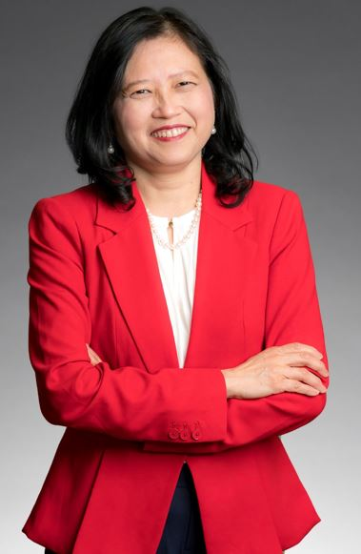
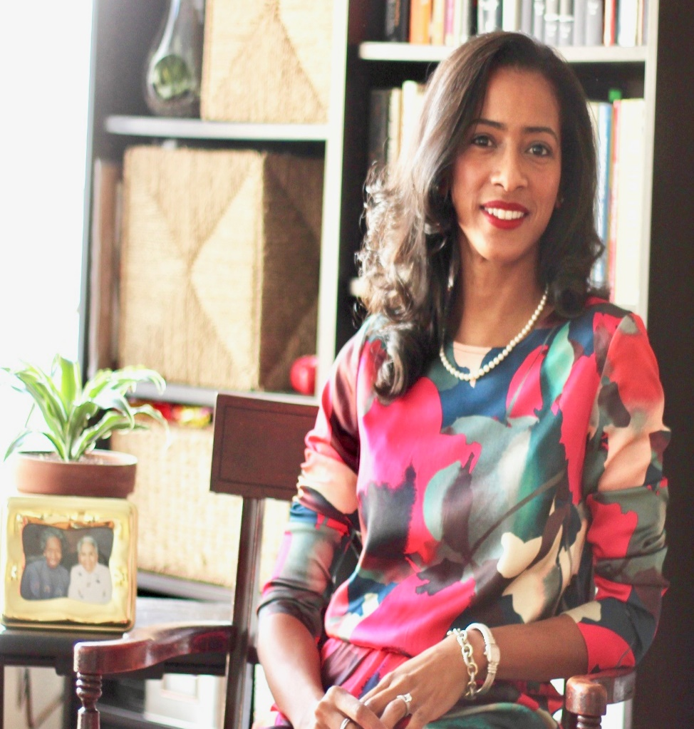
Speakers
Ryane LeCesne
Transformation Mindset Coach
CEO of INSPIRE Brand Consulting, LLC
Shiau Yen Chin-Dennis
Managing Partner of K&L Gates’ Portland Office

Slide 4
Speakers - Bios
Shauna Bryce
Shauna C. Bryce is a career strategist for lawyers at all levels. Her roster of private clients includes leaders in government, Global 100 law firms, Fortune 500 businesses, and other top organizations—including Google, Dreamworks, Major League Baseball, the U.S. Supreme Court, and the White House. She’s is a graduate of Harvard Law School with 20 years in law and legal careers. As a lawyer, she worked in the Manhattan flagship office of a Global 100 law firm and served on the hiring committee of an Am Law 200 law firm. www.brycelegal.com
LinkedIn: https://www.linkedin.com/in/shaunabryce/
Karen McCain Borno
Karen McCain Borno enables innovation and is known for translating complex technology and business plans into digestible concepts for disparate stakeholders. She advises senior executives on best practices to mitigate risk, and works hand in-hand with compliance and internal audit on matters reportable up through the Board of Directors. She is lead counsel for Verizon’s Business Strategy and Development teams, and oversees legal and regulatory issues arising from transformational projects and M&A.
Karen’s commitment to legal and technology excellence have earned her several awards and recognitions. Most recently, in June 2018 Karen was named a National Bar Association Diversity in Tech Award Winner. More than anything Karen is passionate about creating equality of opportunity. She manages Verizon’s DC Metro Legal Intern program, and co-chairs the Legal Department’s diversity and inclusion council.
LinkedIn: https://www.linkedin.com/in/karen-borno-43b5335/

Slide 5
Speakers - Bios
Shiau Yen Chin-Dennis
Shiau Yen Chin-Dennis is the managing partner of the Portland office of global law firm K&L Gates, and likely the first Asian female partner in a leadership role in a major law firm in Portland. Shiau Yen has years of business and legal experience, focusing her practice on corporate transactions, including mergers and acquisitions, post-acquisition integration, joint ventures, restructuring, corporate governance, and other international transactions.
She serves on the K&L Gates firm widediversity committee; is a co-founder of the Women’s Leadership Alliance; was the firm’s 2014 Leadership Counsel on Legal Diversity fellow; and was recently a featured panelist on the Portland Business Journal’s Thought Leadership Forum on Women in Business. In 2016, she was a recipient of the Portland Business Journal “Women of Influence” award. Shiau Yen currently serves as the Chair of the District Export Council of Oregon (DEC), a position appointed by the U.S. Secretary of Commerce.
LinkedIn: https://www.linkedin.com/in/shiauyen-chin-dennis-a2529b4/
Ryane LeCesne
Ryane Danielle LeCesne is the CEO of INSPIRE, Founder of Finesse School, and a master Transformational Mindset Coach. As a self-proclaimed "personal transformation nerd,” she is known as Your Brilliance Illuminator™. Her purpose and mission are to inspire, support, and guide high-achieving women, and specifically of women of color, to break through self-limiting beliefs; live their Brilliance; and advance their careers or build dream businesses with clarity, confidence, and inner-peace.
Her transformational mindset coaching practice is designed for high-achieving women to quantum leap out of the unconscious fixed mindsets of Impostor Syndrome and Perfectionism that can keep too many women playing small, dimming their lights, and holding back from expressing their true authentic selves. Ryane’s focus is to coach women to illuminate and live their Brilliance – to be empowered to own their unique strengths and gifts that have likely gone unnoticed, under-utilized, and under-nurtured by them.
LinkedIn: https://www.linkedin.com/in/ryanelecesne

Slide 6
Maximize Your Potential: Executive Coaching for Success
Agenda:
Panel Discussion
Questions and Answers
Handout

