Slide 1
Five Strategies for Addressing the Challenges of Being a Manager of Color
Leading to Win in Your Workplace
Panelists:
Rahwa Ghebre-Ab, Esq., Senior Vice President, Business & Legal Affairs, Lionsgate Entertainment
Valerie Kennedy, Esq., Special Counsel, Cravath, Swaine & Moore, LLP

Slide 2
Understanding the Management Landscape
The Primary Goals of Management
“Leadership is the art and science of getting things done through people.” (-Mary Parker Follett)

Slide 3
#1 – Determine and Develop Your Management Style
Set Objectives and Monitor Progress
Establish both management and team objectives
Level-set expectations of what success looks like with both your manager and your team (key performance indicators, etc.)
Monitor team performance, strategy, client value-creation and overall team effectiveness
Plan your work; have a roadmap with key milestones

Slide 4
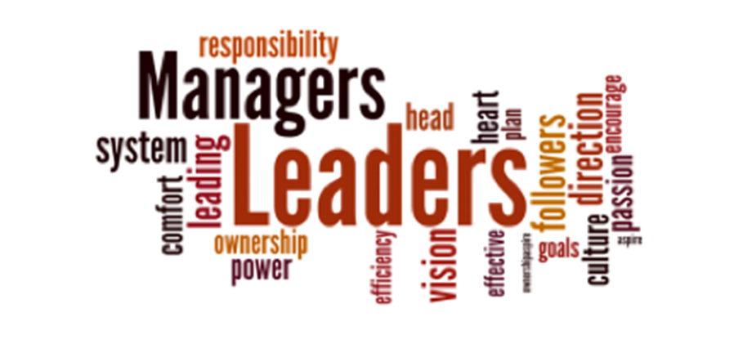
What is Your Management Style?
Are you communicative and collaborative?
Do you micromanage?
Who are you most comfortable with? Do you show a preference towards them?
Do you delegate well or take on everything yourself?
Do you have an executive coach?

Slide 5
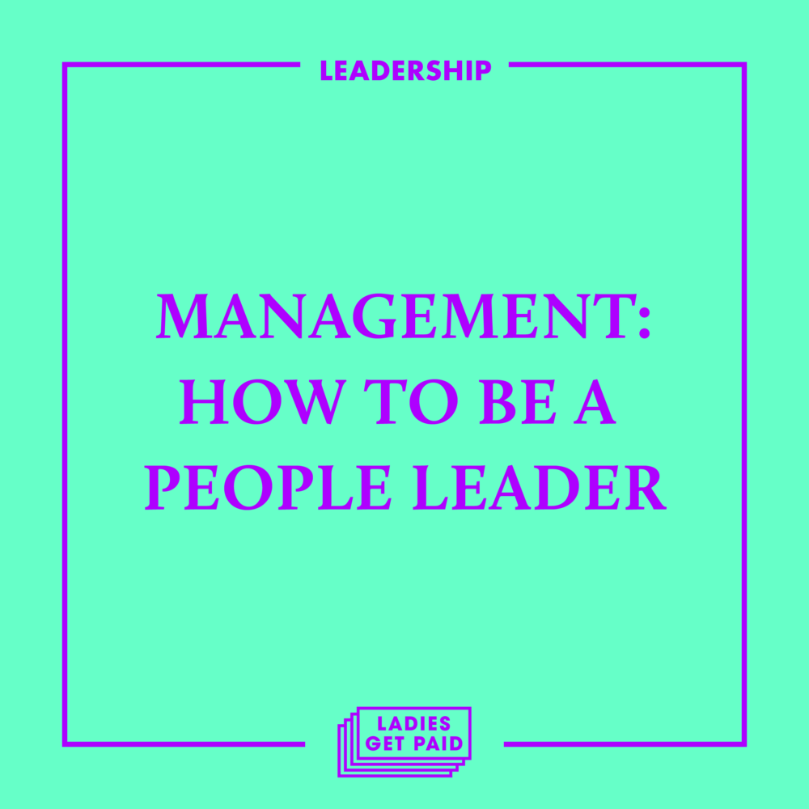
#1 – Determine and Develop Your Management Style
Know Your Organization
Know your organization’s culture and decision-making
Framework:
What traits or practices are valued?
Who makes things happen?
How are decisions made and what processes are involved?
Be aligned with the company’s priorities and chief goals

Slide 6
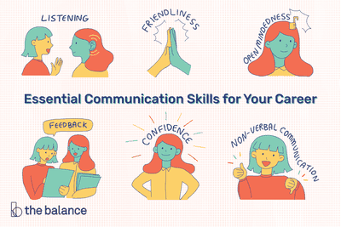
#1 – Determine and Develop Your Management Style
Communication Is Key
Be clear on your communication style
Malleability is a strength!
Be alert to team communication style
Not everyone receives the same message
in the same way
Invest in professional growth & team building
Insights, Meyers –Briggs, etc.
Seek feedback

Slide 7
#2 – Cultivate Your Personal Strategies for Combatting Unconscious Bias
Examples:
Double standards for performance
Microaggressions from peers and direct reports
Managing team members of color
Marginalization or exclusion within key
communication loops
Compensation and decision-making equity
Access to “Old Boy & Old Girl” networks

Slide 8
#2 – Cultivate Your Personal Strategies for Combatting Unconscious Bias
Assess And Set The Tone
Does management welcome and value remedying unconscious bias?
Do you want to be involved in D&I?
Are you forced to be involved with Company D&I initiatives?
Practice self-aware decision-making
Promote self-aware decision-making
Do not allow your experience with unconscious
bias to impact your team negatively
Know when to walk away

Slide 9
#2 – Cultivate Your Personal Strategies for Combatting Unconscious Bias
DEVELOP a values driven and objectives focused management style
IDENTIFY a thought partner and mentor for advice and counsel
BUILD your company brand and allies
TALK with your HR and/or D&I team(s) about constructive ways to address bias through training and engagement (if you so choose!)
ASK to be included and valued
DOCUMENT successes and breakthroughs

Slide 10
Question Break!
Assessing one’s management style and reflection on unconscious bias requires candid self-assessment and confidential third party feedback, if possible:
What or who triggers self doubt or frustration for you at work?
How do you deal with it?
Have you contributed towards difficult dynamics?

Slide 11
Do You Have High EQ or Situational Awareness?
Are you alert enough to how others may perceive you?
Do you understand the importance of impression/reputation management?
Are you able to effectively read a room or discern when race or gender are not factors in a problem or situation?
Are you struggling with Imposter Syndrome or Corporate Stockholm Syndrome—Is your antenna off as a result?

Slide 12
#3 Be Clear (Or Get Clear!) On The Value You Add
Don’t focus on how others are not bringing value – focus on how you are
How do you create value? (ex. content programming, diligent follow-through, engagement on company committees)
Do you actively work on staying ahead of the curve competitively and as a knowledgeable manager?
Are you working to build social capital and alliances?
What is your network like? Who is in it?

Slide 13
#4 Do Your Best To Bring Your Values and Your Professional Self To Work
Merge your professional authenticity with your personal values
How do you define authenticity? How is authenticity weaponized?

Slide 14
#5 – Prepare A Guidemap Moving Forward
Recognize and have a plan of attack for stumbling blocks—protect your flank!
Have a work plan or strategic plan that connects the dots for team members and leadership
Execute key deliverables
Develop next gen skills
Spend time listening to direct reports and peers
Engage in Self Care

Slide 15
THANK YOU!
Contact Information:
Rahwa Ghebre-Ab:
E-Mail: rghebreab@lionsgate.com
LinkedIn: https://www.linkedin.com/in/rahwaghebreab/
Valerie Kennedy:
E-Mail: rghebreab@lionsgate.com
LinkedIn: https://www.linkedin.com/in/rahwaghebreab/

