Slide 1
CCWC Conference GC Training Boot Camp & MBA for Lawyers
It’s Time: How to Write a Book &
Launch a Podcast in 2020
Wednesday, September 25, 2019
3:30 pm – 4:30 pm

Slide 2
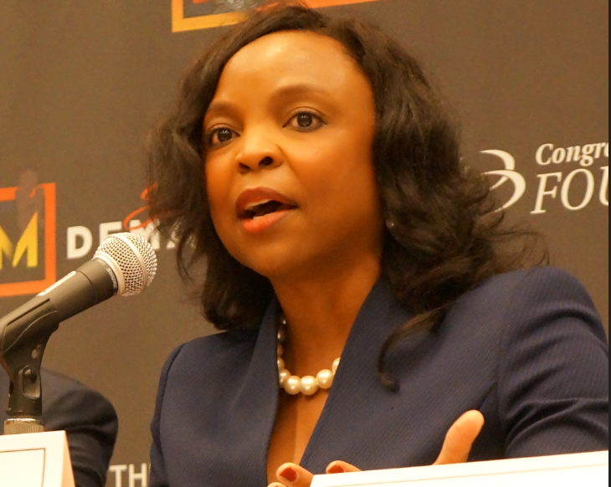
Meet the Speaker
DeMonica D. Gladney, Esq.
In addition to a successful legal career, DeMonica Gladney, Esq., is an accomplished writer, poet and inspirational speaker. She is the bestselling author of three non-fiction books - Identity Theft: Discovering the Real You, Willing to Wait: From Revelation to Manifestation, and Reflections from God. She received the i10-Media Influential Award for Authors and the Houston’s Favorite Author Award for her literary work. Her book, Identity Theft, has been ranked #2, and Willing to Wait, ranked #7 on the BCNN1/BCBC National Independent Publishers’ Top 50 Bestseller’s List. Ms. Gladney has been featured on the Daystar Television Network and various television and radio talk shows around the country, and in print media, including the American Family News, The Christian Post Reporter, the Pearland Reporter News, Houston Forward Times Magazine, Black Christian News Network, Houston Style Magazine and Ladies First Magazine.

Slide 3
Meet the Speaker
Debra Hunter Johnson, Esq.
Debra Hunter Johnson is a speaker, consultant and investor with over 30 years of experience navigating entrepreneurial, large-corporate and nonprofit settings in legal and HR leadership roles. She is the Founder & Principal Consultant of Reciprocity Consulting Group. As a speaker, she offers actionable tips to Accelerate Your Wisdom Curve®. She tells individuals and organizations what they need to know now to more quickly turn missteps and mistakes into lessons learned and winning moments. As a consultant, she helps companies create cultures that thrive from the productivity driven by a diverse, equitable and inclusive workplace. As an angel investor, Debra has a special interest in early stage ventures with founders or CEOs who are women or people of color. Debra writes for the online magazine, PrimeWomen.com, is a Strategist with Kanarys, Inc. and sits on several non-profit boards. She uses writing and podcasts to share her voice and to promote her brand.

Slide 4
Meet the Speaker
Delania Barbee, Esq.
As part of her efforts to address the underrepresentation of Black legal professionals and advance the progression towards a more inclusive legal profession, Delania Barbee, Esq. created and hosts the Practicing while Black podcast, which shares the experiences of Black attorneys in the U.S. and provides career strategies and inspiration. She also hosts workshops and offers consulting to attorneys to help them find their niche and build a platform designed to maximize their impact. In her own career, Delania is the Founder and Managing Attorney of Barbee Law Boutique, PLLC. Through her firm, she helps protect and build businesses and legacies through strategic corporate law and estate planning strategies. Delania is the Immediate Past President of the George W. Crawford Black Bar Association. She received her B.A. cum laude from Smith College and her J.D. from the University of Connecticut School of Law. She is licensed to practice in Massachusetts and Connecticut.

Slide 5
Book? What Are Your Goals?
Why Do You Want to Write Your Book?
How Are You Going to Use Your Book?
Story to tell that will help others?
Brand yourself as SME for other opportunities?
Conversation starter for primary business?

Slide 6
Tips on How to Write a Book
Step 1: Writing the Book
Select a catchy title that will differentiate your book from others in its genre
Develop an outline of the content of your book
Prepare a detailed manuscript of your book
Have your final manuscript edited by a professional editor
Step 2: Designing the Book
Confirm the book specifications (e.g., size, binding styles, cover design)
Confirm the technical needs for your book (e.g., copyright, ISBN, LCCN)
Have the front & back covers of your book designed by a professional graphic designer
Typeset the interior pages of your book, including any special pages
Step 3: Publishing the Book
Consider your available publishing options (e.g., traditional publishing vs. self-publishing)
Review the proposed publishing and/or printing contracts
Confirm your book publishing and/or printing costs
Select a reputable publisher and/or printer to print your books
Step 4: Promoting the Book
Research the target audience that you want to reach
Develop your book marketing plan (e.g., how you will spread the word to sell books)
Prepare your book publicity plan (e.g., how you will get the author into the media)
Set up a professional website where people can buy your books
Confirm your distribution outlets (e.g., distributor, retail stores, online stores)

Slide 7
What Are Your Publishing Options?
BOOK PUBLISHING OPTIONS | PUBLISHER BOOK RIGHTS | AUTHOR BOOK RIGHTS | BOOK PUBLISHING COSTS | BOOK MARKETING/PUBLICITY | BOOK DISTRIBUTION
Traditional Publisher (buys rights to author’s manuscript) | Owns 100% book rights | Paid royalties on book sales | Paid by Publisher | Done by Publisher | Done by Publisher
Subsidy Publisher (publishes book under Its own imprint) | Owns 100% book rights | Paid royalties on book sales | Paid by Author | Done by Publisher | Done by Publisher
Self- Publisher (author publishes book) | None | Owns 100% book rights | Paid by Author | Done by Author | Done by Author

Slide 8
Podcasting
Delania Barbee, Esq.
Ticora Davis, Esq.
Bianca Jordan, Esq.
& James T. Jones, Esq.
Okeoma Moronu, Esq.
*Current podcasts hosted by women attorneys of color
Andrea M. Harvey, Esq.
Reyna Walters-Morgan, Esq.
Ashley Kirkwood, Esq.

Slide 9
What is a Podcast?
Ben Hammersley is often credited with creating the term podcast in a 2004 Guardian article where he explored what to call the “new boom in amateur radio”. The word is thought to be derived from a combination of words “iPod” and “broadcast”.
A podcast is a series of digital audio files made available automatically, on-demand via the Internet for downloading / streaming through an application (“app”) or website. Each podcast episode is typically an individual file. Podcast episodes can be heard on computers, mobile devices, smart speakers, and television (on your Apple TV).
Hosting providers that make the digital audio files available via the Internet include Libsyn and Podbean.
Popular podcast apps include: Apple Podcasts, Stitcher, Spotify, and Google Podcasts.
Podcast episodes are typically released in seasons or on a schedule such as weekly, biweekly, or monthly. In some instances, which are uncommon, they are not released in seasons or on another schedule.
A vlog, which is thought to be derived from a combination of the words “video” and “blog”, is sometimes referred to as “video podcast” (or videocast, vidcasts, or vodcasts). A vlog / video podcast combines the format and audio component of a podcast with visual media. Podcast apps generally do not support video. However, some podcast hosting providers (such as Podbean) provide an option to make video podcasts available. You can also use video platforms such as Youtube or Vimeo to make it available.
This presentation focuses on podcasts in the traditional sense of the term.

Slide 10
Why Podcast?
Nearly 1 out of 3 people listen to one podcast a month. This is an increase from approximately 1 out 4 the prior year. Tom Webster from Edison Research, which covered podcasts since 2006, said this is the largest growth in podcast activity the company has seen since it began to cover podcasts. (Source: Peiser, Jaclyn, “Podcast Growth is Popping in the U.S., Survey Shows.” The New York Times. 6 Mar. 2019)
Podcasts are popular due to:
The current preference for on-demand content (e.g., streaming television shows)
The intimate experience (e.g., the use of voice, a common voice in the listener’s ear regularly, being part of the discussion, learning about the host)
Flexibility in how you experience it (e.g., while exercising, while cleaning, while driving, while cooking)
Podcasting allows you to:
Stay present in front of your target audience
Not worry about visuals or long-form written posts
Connect with thought leaders
Become known as a thought leader
Create an asset

Slide 11
What Are Your Goals for Your Podcast?
Passion Pursuit
Explore an interest outside of law
Example: “Travel Quips” by Reyna Walters-Morgan, Esq.
Extension of Law Practice
Market your legal skills / your law practice
Example: “The Harvey Law Speaks Podcast” by Andrea Harvey, Esq.
Side Hustle or Other Business Venture
Build authority and an expertise outside of the law
Example: “Speak Your Way to Cash” by Ashley Kirkwood, Esq.

Slide 12
Tips on How to Launch an Independent Podcast
Step 1: Decide on Your Goals and Prepare the Structure
Describe your ideal listener
Decide if there will be interviews or a co-host / co-hosts
Select a title that will attract your ideal listener
Select cover art that will attract your ideal listener
Decide schedule (if any) for releasing new episodes
Step 2: Prepare for the Recording Process and Record
Prepare guest or co-host agreements, if applicable
Determine the software that will be used to record
Book interviews or confirm co-host(s), if applicable
Outline and record introductory episode
Record two additional episodes
Edit or have episodes edited
Step 3: Publish
Decide on what platform to host your podcast (e.g., Libsyn, Podbean)
Add your podcast RSS feed to podcast apps such as Spotify, Apple Music, Stitcher, and Google Podcasts
Create a website for show notes
Step 4: Promote Your Podcast
Social media
Serve as a guest
In-person education
Obtain reviews
Create promotional materials
Keep adding new episodes

Slide 13
Examples
Reach out!
Podcasters, News Stations, Public Speakers
Be prepared
Repurpose content
Website, Social Media, Client cultivation
Video Podcast Example

Slide 14
Key Book Resources Summary
Writing, Marketing & Publishing Resources
“How to Publish a Book” by Jerry Jenkins (https://jerryjenkins.com/how-to-publish-a-book/)
“Wally Bock’s Writing Edge” by Wally Bock (https://writingabookwithwally.com/topics/writing-a-book)
“Resonate: Present Visual Stories that Transform Audiences” by Nancy Duarte
“The Self-Publishing Manual” by Dan Poynter
“1001 Ways to Market Your Books” by John Kremer
“The Successful Writer’s Handbook” by Patricia Fry
“Is There a Book Inside of You?” by Dan Poynter & Mindy Bingham
Books in Print - R.R. Bowker (www.bowker.com)

Slide 15
Key Book Resources Summary
Online Publishing Resources
“Take Control with Self Publishing” by Amazon
(https://www.amazon.com/gp/seller-account/mm-summary-page.html?topic=200260520)
Coaching Resources
Jasmine Womack (www.jasminewomack.com)
Victor McGlothin (www.victormcglothin.com)
Arlene Gale (https://bookwritingbusiness.com)

Slide 16
Key Podcast Resources Summary
1. Free Step-by-Step Tutorial - "How to Start a Podcast in 2019: Pat’s Complete Step-By-Step Podcasting Tutorial" by Pat Flynn
(https://www.smartpassiveincome.com/tutorials/start-podcast-pats-complete-step-step-podcasting-tutorial/)
2. Programs: The Ultimate Guide to Getting on Podcasts as a Guest (https://www.podcastmotor.com/getting-on-podcasts-as-a-guest/)
SHOW & TELL:
Podcast Moguls with Nicaila Matthews Okome
(https://side-hustle-pro.teachable.com/p/podcast-moguls)
Power-Up Podcasting with Pat Flynn (https://courses.smartpassiveincome.com/)

Slide 17
Let’s Connect: How to Contact Us
Debra Hunter Johnson
Website: www.debrahj.com
LinkedIn: linkedin.com/in/debra-hunter-johnson-8902127
Delania Barbee
LinkedIn: https://www.linkedin.com/in/dcbarbee
Firm: www.barbeelawonline.com
Podcast: www.practicingwhileblack.com
DeMonica Gladney
Website: www.DeMonicaGladney.com
LinkedIn: https://www.linkedin.com/in/ddgladney/

