Slide 1
Privacy Updates
and the New General Data Protection Regulation (GDPR) Requirements
September 25, 2019

Slide 2
Panelists
Liz Broadway Brown
Jakarra J. Jones
Tomasita Sherer
Francine D. Ward

Slide 3
BigBox’s Dilemna
BigBox Inc. is a global retailer headquartered in NYC, with retail stores in San Francisco, Los Angeles, Chicago, Atlanta, Paris, Brussels, Berlin, Barcelona, and London. BigBox desires to use a variety of tracking technologies throughout its stores, in order to gain valuable consumer information, primarily to provide a better consumer experience.
BigBox wants to use cameras throughout the stores, at every entry-way, in the eyes of every mannequin, at the cashier stands, at the dressing room entrances (but not in individual stalls), facial recognition technology, and a new technology that captures customers’ fingerprints when they touch the payment terminal. BigBox intends to collect information including, but not limited to, the types of items shoppers purchase and assess and their behaviors around such products.
BigBox gathers information about its customers through its website, including each user’s email address, user-specific IP address or mobile device ID (of the smartphone they use to access the BigBox website), and other usage data. Finally, BigBox has a robust social media presence, which it uses to gather information from users, such as their name, personal contact info, billing information, where they went to school, and personal images.

Slide 4
Q: Should BigBox be concerned about GDPR or other privacy laws?

Slide 5
Q: What do privacy laws require of retailers that collect personal information from shoppers via in-store tracking technologies?
It depends on where your stores are located, where the consumers whose information is being collected are located, and what kinds of information you are collecting. Privacy laws vary from jurisdiction to jurisdiction, but generally, they protect “personal information” or “personal data,” which usually means information that can be used to identify a person or a specific device or is tied to a person or specific device.
For example, when personal data is collected from consumers in the European Union or by stores located in the EU, as BigBox intends to do, the General Data Protection Regulation (GDPR) will likely apply.

Slide 6
GDPR
Imposes many robust requirements on companies that collect personal data, including to:
be transparent and provide consumers with clear notice of their privacy practices;
obtain consent to process personal data in certain instances;
ensure the company has appropriate security measures in place to safeguard the data; and
adopt and adhere to a data retention policy, among other requirements
Companies must also provide consumers with certain rights, including:
right to access and correct the information stored about them;
data portability;
erasure (the “right to be forgotten”);
restriction of processing;
to object to processing of one’s personal data; and
“not to be subject to a decision based solely on automated processing, including profiling, which produces legal effects . . . or similarly significant effects”.

Slide 7
U.S. Laws
Federal Laws regulate different types of data, such as:
health information (HIPAA),
financial information (GLBA), and
children’s information (COPPA)
Common to these laws are obligations to:
provide individuals with notice of a company’s privacy practices;
obtain consent for certain information collection, use and disclosure practices; and
safeguard the data using reasonable security measures.

Slide 8
California
California recently enacted the California Consumer Privacy Act (CCPA), which becomes enforceable in 2020.
Like the GDPR, this law introduces specific consumer rights (including the right to access and request deletion of personal information).
Among other requirements, the CCPA also imposes specific obligations on companies that sell consumer personal information.
Several other states have introduced privacy legislation in the last year and we expect more will follow.

Slide 9
Q: What if we are just trying to capture aggregate information, not information about any individual customers?
If you are just trying to capture aggregate information, such as how many people came to your store, where they spent the most time, how they moved through the store, and the like, then you may not trigger any privacy laws.
Every situation is fact specific.

Slide 10
Q: The retail tracking provider we are considering working with offers our customers the ability to opt out of being tracked. Does that help?
A: Probably, yes.
However, how does the opt out work? And, how are the customers informed of the choices they have?
Lawfulness, fairness and transparency
-What does your privacy notice say?
-Is there an in-store mechanism?
-Are you honoring the customer’s choices?
-Are kids involved?

Slide 11
CCPA and GDPR Opt-Out Compared
Notification: Before or at collection, individuals must be notified of the categories of personal information that are being collected
Opt-Out: Businesses must enable and comply with a consumer’s request to opt-out (Cal. Civ. Code § 1798.120)
- Must include a “Do Not Sell My Personal Information” link in a clear and conspicuous location
- Must not request reauthorization for at least 12 months after the person opts-out
- Must train employees on handling consumer’s opt- out requests
Related rights: Right to deletion (Cal. Civ. Code § 1798.105)
Consent: Has the data subject “freely given, specific, informed and unambiguous” consent?
Opt-Out: While “opt-out” rights are not expressly stated, they are in effect since consent can be withdrawn at any time
- Silence, pre-ticked boxes or inactivity does not constitute consent
Related rights:
- Right to rectification (Article 16)
- Right to erasure or “the right to be forgotten” (Article 17)
- Right to restrict processing (Article 18)
- Right to object to processing (Article 21)

Slide 12
Children
CCPA + COPPA
GDPR
Parental consent required for children under 16
Member states have the right to lower the age threshold but not lower than 13
Children must receive an age appropriate privacy notice
Applies to all processing consent requests
Consent required for children under 16
- Children can consent aged 13-16
- Parental consent required for children under 13
COPPA – Applies to any websites or other online services directed to children or that knowingly collect personal information from children and must allow parents to:
- View the personal information collected about their child and
- Delete and correct that information

Slide 13
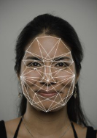
Q: We are thinking about using facial recognition technology and fingerprint scanners to help identify the people coming into our stores. Does that trigger any special concerns?
A: Yes. in some jurisdictions, capturing any data about a unique individual (even if you don’t know who they are and make no effort to find out who they are) may trigger the application of privacy laws if you use a unique identifier to track them or if the image could be linked to a customer.

Slide 14
Q: We are thinking about using facial recognition technology and fingerprint scanners to help identify the people coming into our stores. Does that trigger any special concerns?
Because biometrics are the most “personal” of personally identifiable information, several states (currently Illinois, Washington, and Texas, with other states considering similar legislation) regulate their use.

Slide 15
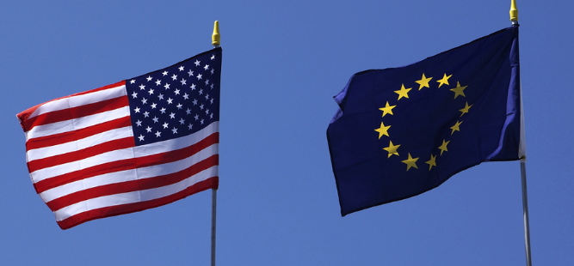
Q: Can you tell me more about the U.S. and EU biometrics laws and how they are enforced?
In Illinois, Washington, and Texas (with other states considering similar legislation), attempting to identify an individual using facial recognition or fingerprint scanning technology will trigger laws governing biometric data.
Similarly, in the EU, biometric data that is used for the purpose of uniquely identifying a person is considered a “special category of personal data” for which processing is prohibited absent explicit consent or unless other exemptions apply.

Slide 16
Q: Can you tell me more about the U.S. and EU biometrics laws and how they are enforced?
Illinois Biometric Information Privacy Act
What is Biometric Data? Retina, Iris or Hand Scans; Fingerprints, Voiceprints and Photographs
Passed in 2008; Five Class Actions Filed in 2015
Requirements: (1) Informed Consent; (2) Limited Disclosure; (3) No Profit; (4) Protect and Retain
Penalty: $1,000 Per Negligent Violation; $5,000 Per Intentional Violation

Slide 17
Q: Can you tell me more about the U.S. and EU biometrics laws and how they are enforced?
Texas Business and Commerce Code
What is Biometric Data? Retina, Iris or Hand Scans; Fingerprints, Voiceprints and Photographs
Requirements: (1) Informed Consent; (2) Limited Disclosure; (3) No Profit; (4) Store & Protect; (5) Destroy after one year
No private right of action.

Slide 18
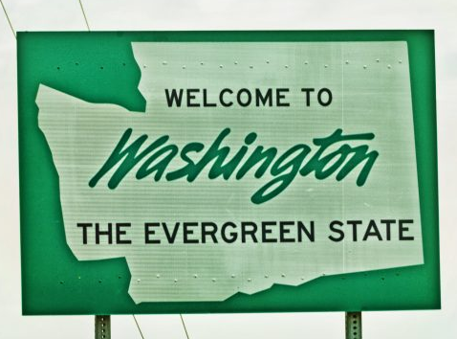
Q: Can you tell me more about the U.S. and EU biometrics laws and how they are enforced?
Washington House Bill 1493
What is Biometric Data? Retina, Iris or Hand Scans; Fingerprints, Voiceprints and Photographs
Signed into law on in 2017
Prohibits anyone from “enrolling a biometric identifier in a database for commercial purpose, without first providing notice, obtaining consent, or providing a mechanism to prevent the subsequent use of a biometric identifier for a commercial purpose.”
No private right of action.

Slide 19
Q: We are thinking about using facial recognition technology and fingerprint scanners to help identify the people coming into our stores. Does that trigger any special concerns?
Key Take-Aways:
Be mindful of current and emerging U.S. and EU laws and regulations.
Make sure your Privacy Policy addresses the collection and use of biometric data.
Obtain informed consent before collecting or using any biometric data.

Slide 20
Q: How do companies approach drafting and implementing data privacy policies and thinking about ethical and reputational concerns?
Inclusions in Your Privacy Policy
What information is collected
How it is collected
How its used
In case of a data breach …what?
Disclosures
Your rights
Changes to the policy

Slide 21
Q: How do companies approach drafting and implementing data privacy policies and thinking about ethical and reputational concerns?
What is Collected?
Name, contact info, employer, job title, credit card info, any identifier by which you may be contacted online or offline.
Internet usage, equipment type, IP addresses, info collected via cookies, web beacons, & other tracking technologies.

Slide 22
Q: How do companies approach drafting and implementing data privacy policies and thinking about ethical and reputational concerns?
What else might be Collected?
Records, correspondence, and other forms of communication user submits when contacting company
Info from online forms, and info provided when user signs up for an event or membership program
Info provided when user requests information about services
When user participates in a survey, contest, or responding to an online event evaluations
Details of transactions when user makes an order

Slide 23
Q: How do companies approach drafting and implementing data privacy policies and thinking about ethical and reputational concerns?
How Data is Collected?
Through a website
Through Apps
In email, text, and other electronic messaging between users to the website
When users interact with your Ads & Apps on 3rd party sites that link to your policy
Face to face contact

Slide 24
Q: We are thinking about using facial recognition technology to help identify the people coming into the store. Does that trigger any special concern?
How Data is Collected?
Through the website
Through Apps
In email, text, and other electronic messages between users to your website and you
When users interact with your Ads & Apps on 3rd party sites that link to your Policy
Face to face contact

Slide 25
Why is Data Collected
Enables company to improve its website
Delivers a better and more personalized customer experience
Allows company to estimate audience size and usage patterns
Stores information about users’ preferences
Allows company to customize its website for individual needs
Speeds up user searches
Recognizes user when they return to company’s website.

Slide 26
Q: How do companies approach drafting and implementing data privacy policies and thinking about ethical and reputational concerns?
Other Important Items
Third-party use of cookies and other tracking technologies.
Disclosure of your information.
Choices about how we use and disclose your information.
Tracking technologies and advertising
Disclosure of your information for third-party advertising. Promotional offers from the company. Targeted advertising.

Slide 27
Q: How do companies approach drafting and implementing data privacy policies and thinking about ethical and reputational concerns?
Your Rights
You can access your data
You can correct your data
Request that it be deleted
Broad rights under GDPR & CCPA

Slide 28
Q: How do companies approach drafting and implementing data privacy policies and thinking about ethical and reputational concerns?
Take-Aways
Have a Privacy Policy if you are doing business with anyone in CA or the EU
Periodically review it as the law continuously
Do your due diligence
Be transparent, even if a breach occurs

Slide 29
Q&a

