Slide 1
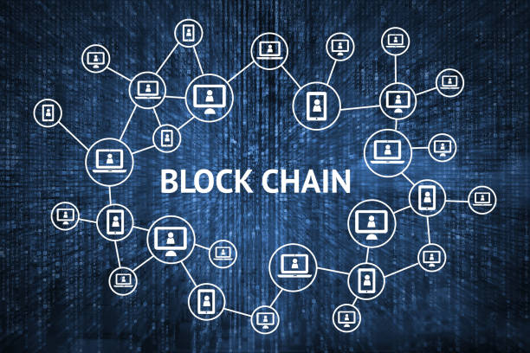
Blockchain and Cryptocurrencies 101
Tracey Salmon-Smith – Partner, Drinker Biddle & Reath LLP
Andrea R. Watson – Group Counsel, Intel Corporation
Erica Williams, PC – Partner, Kirkland & Ellis LLP
118780479v.2 2019-05-10
CCWC – General Counsel Training Boot Camp - Sept. 25, 2019

Slide 2
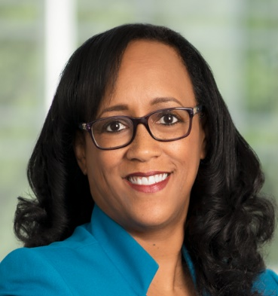
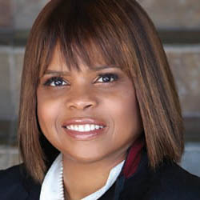
Presenters
Tracey Salmon-Smith is a partner at Drinker Biddle & Reath LLP in the Commercial Litigation Group/Broker-Dealer Team. She assists clients in complex commercial disputes, including class and collective actions, and internal investigations. She also advises clients on e-discovery and information management issues.
Andrea Watson is the Group Counsel for the Compute Performance and Developer Products group and the Advanced Rendering and Visualization group at Intel Corporation. In these roles, Andrea is the lead counsel to cross-functional teams that bring Intel software products to market in the areas of artificial intelligence, rendering, autonomous driving, analytics and high performance computing.
Erica Williams is a partner in the Government, Regulatory & Investigations Group of Kirkland & Ellis LLP. She focuses her practice on internal investigations and defense of companies and individuals accused by the government of involvement in securities law violations, white-collar crime and other major business litigation disputes and crises.

Slide 3
What Is This Technology Called Blockchain?
Blockchain is a distributed ledger technology designed to securely record transactions in or ownership of digital assets.
Bitcoin, the digital currency introduced in 2008, is the first example of blockchain technology.
Key characteristics
1. Digital signatures
2. Blockchain a/k/a hash-linked data structure
3. Consensus mechanism
4. Code execution

Slide 4
What Is This Technology Called Blockchain? (cont’d)
A blockchain is a spreadsheet in the cloud that can be programmed to record and track anything of value.
It can be either public or private
Once a transaction occurs, a record is created and is validated globally by computers participating in the network called “nodes”
Each node maintains its own separate and complete copy of the entire ledger
Node operators are sometimes called “miners” or participants and they validate transactions and update the ledger to record the confirmed transactions
Once the transaction is validated, the record is permanent and immutable.

Slide 5
What Is This Technology Called Blockchain? (cont’d)
A blockchain stores information in blocks that are all chained together in a continuous line
A “hash” value is a unique string of numbers and letters assigned to each block. If a block is altered, the hash number changes.
Each user has an public key and a “private key.” The private key allows the user access to his or her virtual “wallet”, which contains the digital assets held by the user on the blockchain
Before a new block is added, a cryptographic puzzle must be solved which creates the block. Whichever computer solves the cryptographic puzzle, it shares the solution to all the other computers on the network, this is called “proof-of-work.”
The entire network of computers will verify this proof-of-work that the original computer solved, and if correct, the block will be added to the chain.
Notes:
This phenomenon allows the network to confirm, validate, and build trust with each transaction so the user can simply interact with the data that has already been fully insured. This is a great segue into one of the most important features of blockchain technology and how it transfers total power to the user

Slide 8
Introduction to Digital Assets, Cryptocurrencies and Virtual Tokens
A cryptocurrency is a digital asset in which encryption techniques are used to regulate the generation of units of currency and verify the transfer of funds, operating independently of a central bank. Similar technology can create more complex digital assets, or cryptoassets.

Slide 9
Introduction to Digital Assets, Cryptocurrencies and Virtual Tokens
Digital assets, cryptocurrencies and virtual tokens, for purposes of this presentation, all leverage blockchain technology to validate and secure transactions through user consensus using cryptography on a decentralized, immutable ledger that runs on a peer-to-peer network
Bitcoin (BTC), a type of digital asset or cryptocurrency, was the result of decades of work in computer technology and is not the first cryptocurrency:
Digicash (1995-1998)
Hashcash (1997)
B-Money (1998)
Liberty Reserve (2006-2013)
BTC (2008-Present)

Slide 10
Why Are Digital Assets And Cryptocurrencies In The News?
Cryptocurrency market cap, and impact on the money supply, continues to grow
Perception as an increasingly valuable hedge against state-backed monetary intervention, malicious (e.g. corruption) or otherwise
Level of recognition amongst governments is increasing
New financial instruments are being derived using cryptocurrency (e.g., initial coin offerings; futures trading on the CME by 2018)
Regulatory regimes globally vary from regulatory sandboxes to closure of exchanges. Many are approaching with light touch regulation to manage regulatory arbitrage
Increased adoption of Bitcoin and other cryptocurrencies across the financial sector lay the groundwork of a native financial fabric across the internet, enabling the development of second generation blockchain innovations

Slide 11
Different Types of Cryptocurrencies
Top 5 Cryptocurrencies by Market Cap
 | Coin | Ticker | Market Cap | Q1 2018 Price Range (Q1 low – Q1 high) | Coins In Circulation | Settlement Time | Launch
 | Bitcoin | BTC | $116.8B | $6,121 - $17,559 | 16.9M | 10 minutes | 2009
 | Ethereum | ETH | $38.9B | $404 - $1433 | 98.5M | 12-14 seconds | 2015
 | Ripple | XRP | $20.0B | $0.53 - $3.75 | 39B | 4 seconds | 2012
 | Bitcoin Cash | BCH | $11.9B | $748 - $2,954 | 17M | 10 minutes | 2017²
 | Litecoin | LTC | $6.6B | $107 - $321 | 55.8M | 2.5 minutes | 2011
CoinMarketCap.com/currencies/bitcoin/historical-data/
Bitcoin Cash was part of the Bitcoin blockchain from 2009 until it was spun out, or “forked,” in 2017
All figures as of 3/31/18, CoinMarketCap.com
4

Slide 12
Cryptocurrencies
Crypto-
Currency
% of the market
“Claim to fame”

Slide 13
Introduction to Digital Assets, Cryptocurrencies and Virtual Tokens
BTC addresses the longstanding difficulty that confronts digital assets, knowns as the “Double-Spend
Problem” in computer science:
Double-Spend Problem – Risk that a digital currency, whose ownership is represented by
computer code, could be spent twice
BTC leverage blockchain and distributed ledger technology to ensure that all users (“nodes”) can
Come to a consensus on recording and verifying transactions such that one user would not be
Able to send the same BTC twice
BTC enables trust between two unrelated parties on a untrusted network

Slide 14
Initial Coin Offerings (“ICO”)
Initial Coin Offering - The cryptocurrency equivalent of an initial public offering
Entities wishing to raise funds will offer coins or other digital mediums to interested investors for either traditional currency or existing digital assets. In turn, the entity trying to raise capital will receive the funding and investors will hold assets they anticipate will grow in value.

Slide 15
Sample ICO Usage
Company A has an idea to build a product that uses blockchain or distributed ledger technology
To fund the product development, Company A creates a new virtual token that it markets and sells to interested investors in exchange for Ether.
Company A seeks to raise usually a predetermined amount, with minimums and a maximum cap, over the course of hours, days or weeks
Investors range from retail investors interested in particular companies, products, people or investment gains to institutional investors looking to make a VC-style investment in a startup company

Slide 16
Five Things to Know About ICOs
ICOs can be securities offerings
ICOs may need to be registered
Tokens sold in ICOs can be called many things
ICOs may pose substantial risks
Ask questions before investing
“While these digital assets and the technology behind them may present a new and efficient means for carrying out financial transactions, they also bring increased risk of fraud and manipulation because the markets for these assets are less regulated than traditional capital markets.”
- SEC Spotlight on Initial Coin Offerings- Feb 2019

Slide 17
Overview of U.S. Regulatory Landscape - Federal
There are disparate classifications of cryptocurrencies by U.S. regulators
Regulators’ Varying Definitions of Cryptoassets
Treasury | Cryptocurrency is money
IRS | Cryptocurrency is property
SEC | Certain tokens are securities
CFTC | Cryptocurrency is a commodity
FinCEN | Cryptocurrencies subject to money transmitter, AML and KYC rules and regulations
The CFTC has taken the position that Bitcoin and certain other cryptocurrencies are “commodities” that are regulated under the Commodity Exchange Act.
The SEC and its staff have taken the position that certain virtual tokens offered in an ICO meet the Howey Test definition of an investment contract, and therefore, are considered “securities” under the Securities Act of 1933 and are required to register ICO offerings or rely on an exemption from registration such as Reg A or Reg D
SEC has also noted that entities that match buyers and sellers of cryptocurrencies need to register as an exchange or rely on an exemption from registration such as being an ATS
Under the Treasury’s position that cryptocurrencies are money, FinCEN’s money transmitter, anti- money laundering and know-your-customer rules and regulations apply
17

Slide 18
Overview of U.S. Regulatory Landscape - SEC & CFTC Joint Statement on Cryptocurrencies
▪
The SEC and CFTC issued a joint statement in the Wall Street Journal
Regulators Are Looking at Cryptocurrency
At the SEC and CFTC, we take our responsibility seriously.
Jay Clayton and J. Christopher Giancarlo | January 24, 2018
When market participants engage in fraud under the guise of offering digital instruments – whether characterized as virtual currencies, coins, tokens, or the like – the SEC and the CFTC will look beyond form, examine the substance of the activity and prosecute violations of the federal securities and commodities laws. The Divisions of Enforcement for the SEC and CFTC will continue to address violations and bring actions to stop and prevent fraud in the offer and sale of digital instruments.
The SEC and CFTC pledged to continue to work together with other regulators to bring transparency and integrity to the cryptocurrency markets to deter and prosecute fraud and abuse.
The SEC is devoting significant portion of its resources to the ICO market
Focus on substance over form
SEC focused on substance of transactions - federal securities laws apply regardless of whether the offered security is labeled a “coin” or “token” rather than a stock or bond
In regards to fraud, the SEC and CFTC will look beyond form and examine the substance of the activity and prosecute violations of the federal securities and commodities laws
SEC and CFTC will continue to address violations and bring actions to stop and prevent fraud in the offer and sale of digital instruments
18

Slide 19
Overview of the U.S. Regulatory Landscape – SEC Application of the “Howey Test”
The SEC has said it will use fact-based inquiry to determine if a digital product is a security – a “facts and circumstances test”
The burden of demonstrating that a product is not a security is on the promoter of such product
In DAO investigation, SEC undertook “Howey Test” analysis to conclude that DAO Tokens are securities and to assert its jurisdiction over virtual organizations that raise capital using similar processes and technologies
Under the “Howey Test,” a security includes an investment contract with the following elements:
Investment of money
In a common enterprise
With reasonable expectation of profits
Derived solely from the entrepreneurial or managerial efforts of others
10

Slide 20
Current SEC views
“… those who operate systems and platforms that effect or facilitate transactions in [digital assets] should be aware that they may be operating unregistered exchanges or broker-dealers that are in violation of the Securities Exchange Act of 1934…
If a platform offers trading of digital assets that are securities and operated as an exchange, as defined by federal securities laws, then the platform must register with the SEC as a national securities exchange or be exempt from registration.”
- SEC Spotlight on Initial Coin Offerings – Feb 2019

Slide 21
Overview of U.S. Regulatory Landscape - States
State-level regulation vastly varies from state-to-state
Certain states such as Wyoming and Arizona proposed and/or passed legislation that seeks to bring more cryptocurrency-related businesses to their states
Others have taken a firm stance and have recently pursued a number of enforcement actions against issuers and other participants in ICOs or cryptocurrency businesses (e.g., Texas, Massachusetts)
Source: Investopedia.com
11

Slide 22
What is a “Smart Contract”?
A “smart contract” is a set of coded computer functions.
May incorporate the elements of a binding contract (e.g., offer, acceptance, and consideration), or may simply execute certain terms of a contract.
Allows self-executing computer code to take actions at specified times and/or based on reference to the occurrence or non-occurrence of an action or event (e.g., delivery of an asset, weather conditions, or change in a reference rate).

Slide 23
Character of Smart Contract
A “smart contract” is not necessarily “smart.”
The operation is only as smart as the information feed it receives and the machine code that directs it.
A “smart contract” may not be a legally binding contract.
It may be a gift or some other non-contractual transfer.
It may be only part of a broader contract.
To the extent a smart contract violates the law, it would not be binding or enforceable.

Slide 24
Understanding Smart Contracts
Key attributes of a smart contract include:
Can authenticate (counter-) party identities, the ownership of assets and claims of right
Can access or refer to outside information or data to trigger action(s)
Can automate execution processes
Smart contracts use digital signatures – private cryptographic keys held by each party to verify participation and assent to agreed terms.
Smart contracts use oracles – a mutually agreed upon, network- authenticated reference data provider (potentially a third-party); this is a source of information to determine actions and/or contractual outcomes, for example, commodity prices, weather data, interest rates, or an event occurrence.
Self-execution: A smart contract will take actions, e.g., disperse payments, without further action by the counterparties.

Slide 25
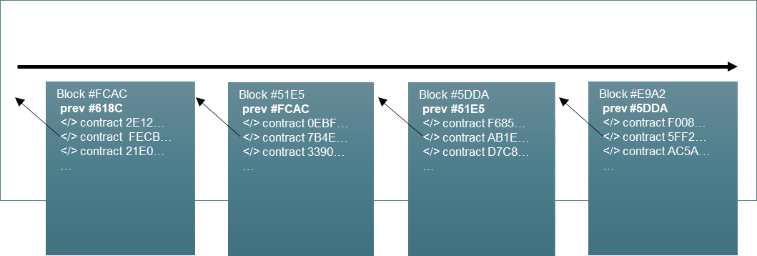
Smart Contracts Leverage Blockchain Technology
Smart contracts can be stored and executed on a distributed ledger, an electronic record that is updated in real-time and intended to be maintained on geographically disperse servers or nodes.
Through decentralization, evidence of the smart contract is deployed to all nodes on a network, which effectively prevents modifications not authorized or agreed by the parties.
Blockchain is a continuously growing database of permanent records, “blocks,” which are linked and secured using cryptography.‡
Blockchain of Smart Contracts

Slide 26
Potential Benefits of a Smart Contract
The attributes of a smart contract give rise to potential benefits throughout an economic transaction lifecycle, e.g., formation, execution, settlement.
BUSINESS INNOVATION
Automating flow of digital assets and payments may foster new products and business models.
STANDARDIZATION
Standardized code and execution may reduce costs of negotiations and agreements.
REGULATORY INNOVATION
SECURITY
Transactions are encrypted and stored on a distributed ledger intended to be immutable.
Examples include:
Built-in regulatory compliance
(e.g., cannot sell to a non-Eligible Contract Participant (ECP); cannot sell until mandated period has passed; or must report certain data).
New regulatory reporting models
(e.g., smart contracts automatically report data at pre-determined intervals).
Stress testing built into smart contracts and regulatory nodes (e.g., execute scenarios on smart contracts to determine payouts across the network).
ECONOMY AND SPEED
Automation reduces transaction times and unnecessary manual processes.
CERTAINTY
Well-designed smart contracts execute automatically thereby reducing counterparty risk and settlement risk.
26

