Slide 1
Effective Ways to Handle Government Investigations and Implementation after Findings Presented by: Fiona A. Philip, Sidley LLP Marisol Rubecindo, JP Morgan Lynne Delisi, Novartis
Fiona A. Philip
Scott R. Lassar
Ike Adams

Slide 2
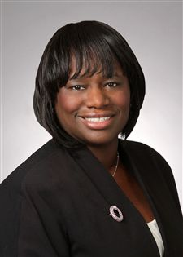
Fiona A. Philip
Washington, D.C. Partner
Securities & Derivatives Enforcement and Regulatory
Fiona represents corporations, officers and directors, and other individuals in a range of government and regulatory investigations. Fiona also conducts internal investigations involving the Foreign Corrupt Practices Act (FCPA), insider trading, accounting and internal controls irregularities, disclosure fraud, and corporate governance issues.
From 1999 to 2005, Fiona . As Enforcement Counsel to the Chairman of the Securities and Exchange Commission (SEC), Fiona worked closely with the Division of Enforcement and Office of the General Counsel to craft policy and guidance for SEC Enforcement staff and to ensure consistency in Commission policy. Prior to her work with the Chairman’s Office, Fiona spent three years as Counsel in the SEC’s Division of Enforcement, where she was one of the original members of the Division’s Financial Fraud Task Force.

Slide 3
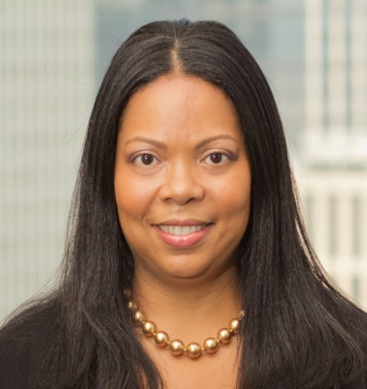
Marisol Rubecindo Executive Director, Assistant General Counsel
Marisol Rubecindo is an Executive Director, Assistant General Counsel in the Government Investigations & Regulatory Enforcement (GIRE) group within JPMorgan Chase & Co.’s Litigation Department. She co-manages the Regulatory Response Team, which handles government investigations and regulatory requests from SROs and exchanges stemming from sales practice, fraud and other potential violations of Federal and state laws and regulatory rules. Marisol has also served as a regulatory attorney within GIRE.
Prior to joining JPMorgan in 2009, Marisol was an associate at both Davis Polk & Wardwell and at Sidley Austin LLP. Marisol began her career at the United States Securities and Exchange Commission.

Slide 4
Lynne Delisi Novartis Pharmaceuticals Corporation
Lynne provides strategic focus by managing a docket of complex high stakes investigations with various government agencies. Her contributions focus on minimizing risk for Novartis Pharmaceuticals Corporation by an evaluation of evidence and identification of trends affecting enforcement actions against pharmaceutical companies in the US as well as investigations strategies for the benefit of Novartis Group. Lynne provides regular updates about progress of government investigations and enforcement trends to business and legal leadership. Lynne is responsible for NPC’s investigations docket and manages a highly complex matrix of litigation counsel teams. Lynne works closely with Compliance leadership to provide counseling throughout NPC to clients on risk minimization issues.

Slide 5
What Triggers a Government Investigation?
Investor/whistleblower complaints
Dodd-Frank created bounty program for whistleblowers who provide information that lead to enforcement actions with penalties greater than $1 million
10-30% of money collected as a result of tip
Referrals from the Division of Corporation Finance and OCIE
Investigative curiosity (industry surveys)
Financial restatements
Significant financial reporting issues (e.g., onetime charges or write downs) or disagreements with auditors disclosed in Forms 8-K
News coverage/academic studies (e.g., stock options backdating)
Civil litigation
Tip from competitor

Slide 6
What Should Corporate Counsel Do?
Don’ts
Dialogue with government staff (no “casual calls” with government personnel)
Assume the government doesn’t have an investigative agenda
Assume cooperation = no enforcement action (a fine line between advocate and cooperator)
Assume OCIE staff/Corporation Finance is not working closely with the Division of Enforcement
Assume other regulators will allow any one agency to control the investigation (i.e. an investigation by one agency won't necessarily preclude another agency from conducting its own investigation)

Slide 7
What Should Corporate Counsel Do?
Involve experienced government investigations counsel
Document preservation (both hard copy and electronic)
Caution: Broadly disseminated document preservation notice can increase likelihood of a leak
Investor relations contingency planning
Personnel actions (administrative leave, temporary reassignment, enhanced supervision, etc.)
Question whether the matter warrants an independent, internal investigation
Caution: Consider Ethical Considerations:
Independence / Conflicts of Interest
Qualifications of Investigator
Privilege

Slide 8
What Should Corporate Counsel Do?
Make appropriate reports to Board of Directors and relevant Board Committees
Exercise considered judgment in timing of proactive disclosures to regulators, outside auditors, and underwriters’ counsel
Consider public disclosure obligations:
Formal vs. informal investigations
Form 8-K obligations (Item 4.02)
Credit Providers and Rating Agencies
Continuing Disclosure Agreements
Debt covenants

Slide 9
How to Mitigate
Be Proactive: get arms around facts early and develop themes of defense
Be Cooperative: strike the right tone with the government investigative staff to establish credibility and earn goodwill
Self Police: identify causes of misconduct and take clear and decisive action

Slide 10
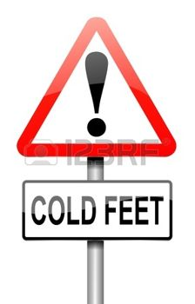
How to Mitigate
Remediation: punish misconduct and implement procedures/enhancements to prevent its recurrence
Reinforce Core Values: set the right tone from the top
No Cold Feet: the government investigative staff will not give credit for self-policing and remediation plans if you don’t follow through

Slide 11
How to Mitigate
Dialogue with the investigators in order to understand their theory of the case and their level of interest in pursuing an action
Where possible, preempt the Wells process by asking for meetings to address their concerns and, if necessary, submit position papers to advocate strengths of your case (and point out weaknesses of theirs)
Identify who needs separate counsel and, if appropriate, assist in the selection of legal representation
Goal is to achieve a soft landing!

Slide 12
Triggers for Internal Investigation
Internal Audit
Demand by Outside Auditor
Regulator Inquiry
Whistleblower

Slide 13
Selecting the Right Process
Ask key process questions at the start . . . and throughout:
Who will be investigated?
How serious?
Who should investigate?
Who should they report to?
What is scope / depth of investigation?
Yates Memo: Look at Individuals
OVERALL: Ensure credibility of investigation

Slide 14
Who Should Conduct the Investigation?
Managers?
Pros
familiarity with company structure and its procedures
quick response time
employee comfort and candor
lower cost
Cons
lack of experience; lack of legal advice in early stages
no attorney-client privilege
may lack objectivity/independence
may have conflict of interest
Compliance/In-House Counsel?
Pros
likely to be quick, more efficient and less expensive
familiarity with company structure and procedures
employees may be somewhat more comfortable
Cons
competing time demands
may lack experience in investigating techniques
may weaken privilege claims
may be less objective, from outside perspective

Slide 15
Who Should Conduct the Investigation?
Regular Outside Counsel?
Pros
familiarity with company and its practices
have sufficient background on legal and regulatory issues to act quickly and efficiently
protects privilege
Cons
may lack internal investigation expertise
may be less objective
may be subject to claim of conflict of interest
Outside Counsel Retained Solely For The Investigation?
Pros
stronger statement of independence and objectivity
benefits of investigative experience and substantive expertise
avoidance of any appearance of conflict
protects privilege
Cons
less familiar with company, its business and its personnel
may cause greater alarm among employees
higher cost

Slide 16
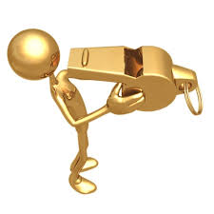
Some Key Points for Internal Investigations After a Whistleblower Complaint
Respect the allegations
Treat whistleblower, et al. as potential government witness
Ensure steps are documented / proper warnings are given
Address confidentiality / privilege issues early
Be mindful of reporting windows (i.e. 120-day SEC window)
Beware of internal pressures not to rock the boat
Respond to negative findings appropriately

Slide 17
Upjohn Warnings to Witnesses
We represent the Company, not you
What you say is privileged as part of the Company’s attorney-client privilege
But the Company could decide to disclose what you say
Keep confidential the questions and answers in this interview
NOT: You can’t discuss the subject with others
Required by Illinois Rule of Professional Conduct 1.13(f):
In dealing with an organization’s directors, officers, employees, members, shareholders or other constituents, a lawyer shall explain the identity of the client when the lawyers knows or reasonably should know that the organization’s interests are adverse to those of the constituents with whom the lawyer is dealing.

Slide 18
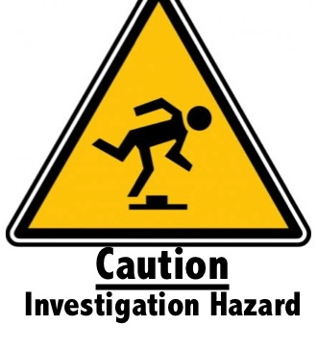
Privilege Issues and Yates Memo
May require waiver of privilege to explain investigation step
Unique conflict of interests issues raised by the new emphasis on individual liability
Corporation may need to consider the need for separate counsel at an early stage

Slide 19
Yates Memo: 6 Key Elements Guiding DOJ Investigators
No credit for cooperation unless evidence against individuals disclosed
Criminal and civil investigations to focus on individuals at the start of the investigation
Criminal and civil attorneys handling investigations should be in routine communication with one another
Corporate resolution won’t, in the absence of extraordinary circumstances, provide protection from criminal or civil liability for any individuals
Corporate cases should not be resolved without a clear plan to resolve related individual cases
Civil attorneys should consistently focus on individuals as well as the company and evaluate whether to bring suit regardless of individual’s ability to pay

Slide 20
Avoid a Whistleblower Retaliation Claim
Determine employee’s status and applicable rules early
“Negative employment action” construed broadly
If discipline, documenting the basis especially important
In the Matter of KBR
SEC issued cease and desist order prohibiting inclusion of “improperly restrictive language” in employment-related agreements
No evidence that such an agreement had ever prevented an employee from communicating with the SEC
Prohibited language was standard agreement not to discuss particulars of the interview without prior authorization
Confidentiality agreements should include carve-out language for protected activity

Slide 21
QUESTIONS

