Slide 1
What is All the Fuss About? A Discussion About Natural Hair and Recent Case Law
Corporate Counsel Women of Color
NOLA 2017
Presented By
Tracy Sanders, Esq.
September 27, 2017

Slide 2
Introduction

Slide 3
Introduction
Thank You Corporate Counsel Women of Color NOLA 2017 for presenting What Is All the Fuss About: A Discussion About Natural Hair and Recent Case Law.
It is encouraging to see you all of you to have a discussion about this important topic.

Slide 4
Agenda
Bias in the Workplace
Dress and Grooming Codes in the Workplace
Natural Hair/Natural Hairstyle Rules
Strategies for Elimination of Bias

Slide 5
Workplace Goals: Happy and Productive!

Slide 6
What is Bias?
Exclusion
Inclination
Preference
Prejudice
Judgement
Temperament

Slide 7
Bias in the Workplace?
Hiring
Performance Evaluation
Promotion
Assignments/Transfers
Nepotism
Discrimination

Slide 8
Employment Discrimination Law

Slide 9
Employment Discrimination Law
Title VII of the Civil Rights Act of (1964) – prohibits discrimination based on race, color, religion, national origin, or sex.
Age Discrimination Act (1967) – prohibits discrimination based on age 40 and beyond.
ADA (1990) – prohibits discrimination based on disability.
Civil Right Act of (1991) – provides monetary damages for intentional employment discrimination.

Slide 10
EEOC: Federal Enforcement Agency
Equal Employment Opportunity Commission (EEOC) -enforces federal laws that make it illegal to discriminate against a job applicant or an employee because of the person's race, color, religion, sex (including pregnancy, gender identity, and sexual orientation), national origin, age, and disability including genetic information.

Slide 11
CDFEH: State Enforcement Agency
California Department of Fair Employment and Housing (CDFEH) – charged to protect the people of California from unlawful discrimination in employment, housing and public accommodations and from hate violence and human trafficking.

Slide 12
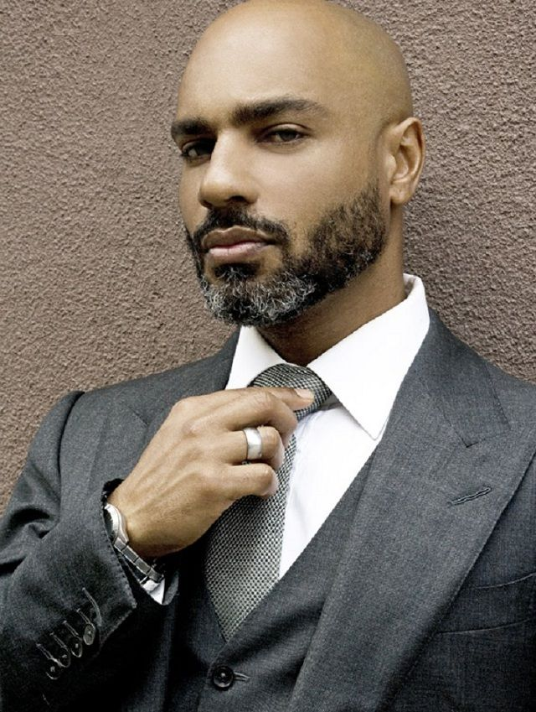
Case Law

Slide 13
Case Law
Case Example: Refusal to hire as a driver offered a lower paid position/Beard
Muslim, Rastafarian, Christian Men (Beard/Long Hair/Dreadlocks) EEOC v. United Parcel Service, Inc. (2004-2015) (According to the EEOC, “no one in this country should have to chose between a job and religious beliefs or practices.”)

Slide 14
Case Law
Compare and Contrast: Refusal to hire/African American Woman/Dreadlocks
EEOC v. Catastrophe (2016) (According to the courts, dreadlocks/braided hairstyles are not immutable racial characteristics protected by Title VII.)

Slide 15
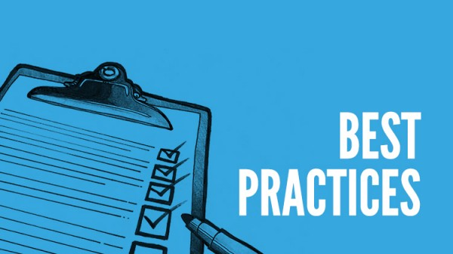
5 Best Practices to Eliminate Bias

Slide 16
5 Best Practices to Eliminate Bias
Establish consistent, fair, and written dress and grooming codes.
Identify and mitigate legal issues by consulting an employment law attorney.
Provide exceptions or accommodations for religion if not undue hardship on employment.

Slide 17
5 Best Practices to Eliminate Bias
Do not establish gender specific dress and grooming codes based on stereotypes.
The EEOC ruled that gender identity is protected as sex under Title VII.

Slide 18
Q & A
Questions & Answers
Giveaways
Thank You!

