Slide 1
Life Sciences Life Cycle:
Women of Color
Corporate Counsel Women of Color
12th Annual Career Strategies Conference
September 21, 2016

Slide 2
Panelists
Michele Buenafe
Morgan, Lewis & Bockius
Jennifer Malatesta
Industry Expert
Cara Edwards
DLA Piper
Melanie Gross
Genentech
Shirell Gross
Bayer
Lillian S. Hardy
Moderator
Adrienne Gonzales
Bristol-Myers Squibb

Slide 3
Agenda
Life Sciences Landscape
01
Promotional Issues
02
Medical Devices – What’s Next?
03
Enforcement Priorities
04
05
Outside Pressure Encouraging Agency Actions
06
What’s Next for the Pharmaceutical Industry?

Slide 4
Life Sciences Landscape
2016 - 2017 Industry Trends and Practice Overview

Slide 5
Promotional Issues
Naming conventions/umbrella branding issues
FDA focus on risk communications
Concerns regarding study design
Cross-agency collaboration to enforce federal priorities

Slide 6
Promotional issues for devices
In vitro diagnostics
Unapproved Zika tests
Genetic testing
Direct-to-consumer testing
Promotion beyond 510(k) or device classification
Cross agency coordination - Federal Trade Commission
Focus Education, LLC
MelApp and Mole Detective
Lumosity

Slide 7
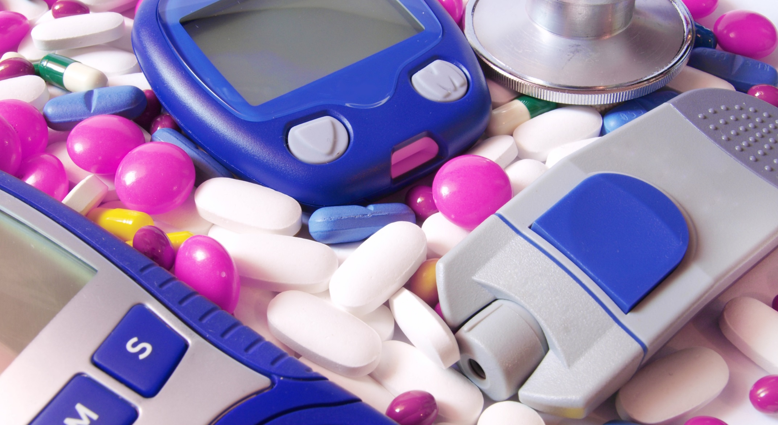
Medical Device Industry: What’s Next?

Slide 8
Devices – The path forward
CDRH priorities and activity for 2016
Key trends that may impact the road forward
Expectations for 2017 and beyond

Slide 9
CDRH Top regulatory science priorities for 2016
Leveraging “Big Data” for regulatory decision making
Using evidence from clinical experience and employing evidence synthesis
Improving the quality and effectiveness of reprocessing reusable medical devices
Enhancing the performance of digital health and medical device cybersecurity
Incorporating human factors engineering principles into device design
Modernizing biocompatibility and biological risk evaluation of device materials
Advancing methods to predict clinical performance of medical devices and their materials
Advancing the use of patient reported outcome measures in regulatory decision making
Collecting and using patient experiences and preferences in regulatory decision making

Slide 10
US Medical Devices – New Technologies
Diagnosis
Genetics (in populations and individuals) through “next generation sequencing” – what is your genotype?
Proteomics – so you have nice genes; are they “expressed?”
Prophylaxis
Imaging technologies
Treating causes before they become intractable or expensive-to-treat outcomes
Notes:
I added this slide back in – it was not in the latest version sent.

Slide 11
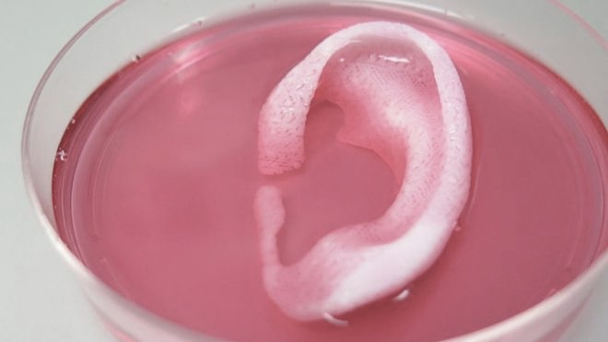
US Medical Devices – New Technologies
Treatment
Personalized or pharmacogenomic-tailored treatments
2016 State of the Union call for cancer vaccines and patient-specific treatments
Tools for biotechnology, like 3D printers for dental, cellular, and reconstructive uses [Doctors 3D-print 'living' body parts, James Gallagher, BBC News website: http://www.bbc.com/news/health-35581454
Notes:
I added this slide back in – it was not in the latest version sent.

Slide 12
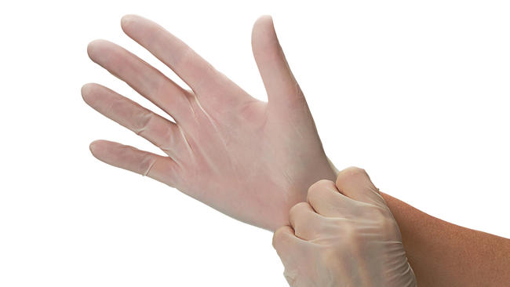
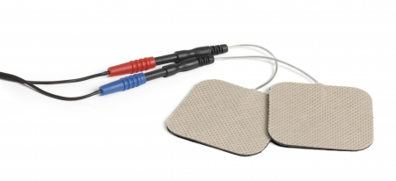
CDRH Activity in FY 2016
Changes to 510(k) - cleared devices
Human factors
Unique device identification
Device classifications/reclassifications
Preamendments devices
Device bans
Reclassifications to address safety issues
De novo petitions

Slide 13
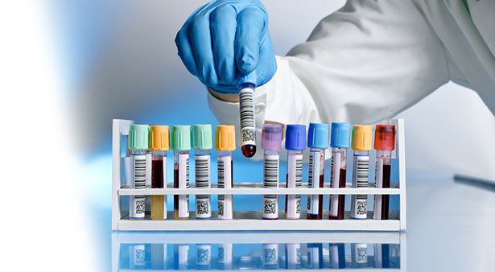
CDRH Activity in FY 2016
In vitro diagnostics
Next generation sequencing
Precision medicine
Direct-to-consumer marketing
Laboratory developed tests
The digitization of device technology
Cybersecurity
Digital health
Postmarket compliance

Slide 14
CDRH Strategic priorities 2016-2017
Establish a National Evaluation System for Medical Devices
Increase access to real-world evidence to support regulatory decision making
Increase the use of real-world evidence to support regulatory decision making
Partner with Patients
Promote a culture of meaningful patient engagement by facilitating CDRH interaction with patients
Increase use and transparency of patient input as evidence in our decision making
Promote a Culture of Quality and Organizational Excellence
Strengthen FDA’s culture of quality within CDRH
Strengthen product and manufacturing quality within the medical device ecosystem

Slide 15
Trends – Novel and evolving technologies
Digital health
Clinical decision support
Next generations sequencing
Personalized medicine
3D printing
Robotics

Slide 16
Trends – Market
Direct-to-consumer health, increased consumer demand for health formation
Increased entry of non-traditional device companies
Continued push to deregulate of low risk technologies

Slide 17
Medical devices – What’s next?
Increased emphasis on individual patient safety
Coordination across technologies and platforms
Software as a medical device
Long-awaited clinical decision support guidance
Anticipated final guidance for device accessories

Slide 18
Medical devices – What’s next?
Policy for regulatory oversight of laboratory developed tests
March forward with UDI implementation
Ongoing MDUFA negotiations
Other legislation?

Slide 19
Outside Pressure Encouraging Agency Action
Enforcement Priorities
and Trends

Slide 20
Compliance Focus and Priorities
FDA compliance and enforcement has received additional funding from Congress
FDA has been using this to beef up its enforcement pool of investigators
Investigators are better trained and more technologically sophisticated
FDA under increased scrutiny from Congress
Influence of media and perceived threats on FDA enforcement priorities
Department of Health and Human Services has ordered coordination among FDA, CDC, Department of Justice, and other agencies in their investigations, particularly in cases of public scrutiny

Slide 21
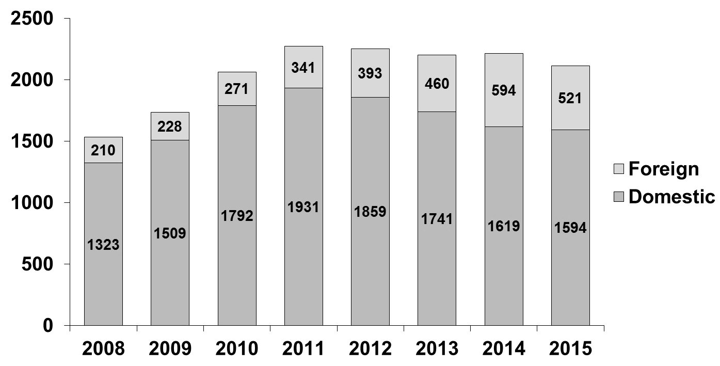
QSR Inspections
Routine Medical Device Quality System Surveillance Inspections CY2008 – CY2014

Slide 22
Inspections OUS
Top 10 Foreign Inspection Locations
Country Name | Number of Inspections
China | 190
Germany | 72
Japan | 37
Taiwan | 29
Switzerland | 25
Canada | 24
Ireland | 23
Republic of South Korea | 23
United Kingdom | 23
France | 16

Slide 23
Outside Pressure Encouraging Agency Action

Slide 24
FDA Reaction to Perceived Public Health Threats (1)
Duodenoscopes
Patient deaths reported from contaminated scopes – large press splash
Senator Patty Murray (D-WA) criticizes FDA oversight of “superbug” outbreaks in February 2015.
FDA conducted a series of inspections at Fujifilm sites from March – May 2015, issuing 483s for each facility.
Senator Murray launched investigation into “superbugs” including demand for documentation from three duodenoscope manufacturers in June 2015.
FDA issued Warning Letters to all three manufacturers (Hoya, Olympus, and Fujifilm) on August 12, 2015.
FDA now investigating manufacturers of AERs (Automated Endoscope Reprocessors)
Custom UltraSonics

Slide 25
FDA Reaction to Perceived Public Health Threats (2)
Directed inspections of two facilities in the US related to vena cava filters and removal components in late 2014
Warning Letter issued in August of 2015
Press reports on Dateline NBC regarding vena cava filter device and related information directly related to the same issues being investigated by FDA
Perceived coordination between FDA, plaintiff’s bar and media
Just before the Dateline NBC story broke, a class-action suit focusing on the same issues was launched

Slide 26
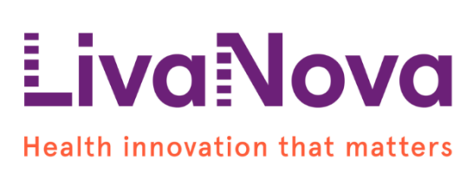
FDA Reaction to Perceived Public Health Threats (3)
FDA inspected the Company’s Munich facility in August 2015 and its Arvada facility from August to September 2015
Focus on 3T Heater Cooler devices and related to contamination
FDA issued a Form 483 identifying two observed non-conformities with certain regulatory requirements at the Munich facility. The Company did not receive a Form 483 in connection with FDA’s inspection of the Arvada facility
Following the receipt of the Form 483, the Company provided written responses to FDA describing corrective and preventive actions that were underway or to be taken to address FDA’s observations at the Munich facility
The Warning Letter issued in December and identified issues not cited during the inspections
Company also on import alert

Slide 27
What's Next for the Pharmaceutical Industry?

Slide 28
Pharma – What’s coming?
Increased emphasis on economics
Expensive products
Payor influence
Public sector costs
Greater attention to incremental benefit over existing therapies
Development of biosimilars
Regulatory scheme
Marketplace
More follow-on products
Different ways of promoting products
Less detailing
More physician-initiated information flow
New technologies
Digital health
Genetic-based medicine
Cellular and tissue-based medicine
Greater transparency
Clinical trial data
Product development info
Regulatory review process
More small, virtual companies
More combinations
Continued low regard for pharma

Slide 29
Life Sciences Life Cycle:
Women of Color
Corporate Counsel Women of Color
12th Annual Career Strategies Conference
September 21, 2016

